Slide 1
Disjoint Set Union
Md Mehrab Hossain Opi

Slide 2
Motivational Problem
Let’s consider a social media like Facebook.
The following rule applies here:
If A and B are friends ,and B and C are friends
Then A and C are also friends.

Slide 3
Motivational Problem
Suppose you got the list of friendships in the form
X1 Y1
X2 Y2
.
.
.
Xi Yi
How can you find if X and Y are friends?

Slide 4
Motivational Problem
What if I ask the question multiple times?

Slide 5
Motivational Problem
Let’s make the problem more realistic.
I will continuously give you some information and ask questions.
Example:
A and B became friends.
Is A and C friends now?
B and C became friends
Is A and C friends now?
How will you answer these questions?

Slide 6
Introduction
Disjoint Set Union (DSU) is a data structure.
Also called Union Find.

Slide 7
Introduction
We are given several elements, each of which is a separate set.
Consider each person a element.
They each belong to a set.
With DSU we can combine two sets.
Make two person friend.
We can check in which set a element belongs.

Slide 8
Introduction
We get three main function:
make_set(v):
Create a new set consisting of the new element v.
union_set(a,b):
Merge two specified sets
Set in which element a belongs.
Set in which element b belongs.
find_set(v):
Returns the representative of the set that contains the element v.
Representative is an element of its corresponding set.

Slide 9
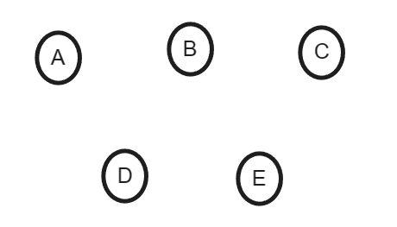
Example
Suppose we have 5 person.
Each person belongs to a set where the person is the representative.

Slide 10
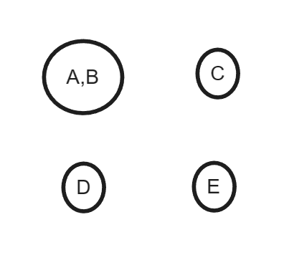
Example
Make A and B friend.
union_sets(A,B)

Slide 11
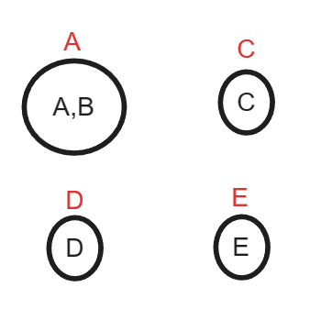
Example
Representative of a set is an element belonging to that set.

Slide 12
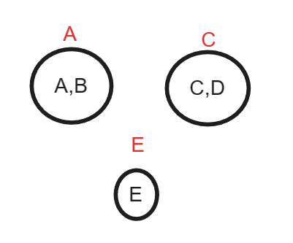
Example
Make C and D friends.

Slide 13
Example
How do we check if A and B are friends?

Slide 14
Example
We have a function to find representative of a set.
find_set(v)

Slide 15
Example
find_set(A): A
find_set(B): A
So A and B are friends

Slide 16
Example
Let’s make B and D friends now.

Slide 17
Example
Representative of B will be A.
Representative of D will be C.

Slide 18
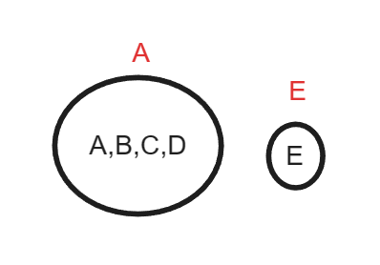
Example

Slide 19
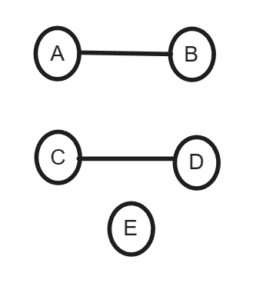
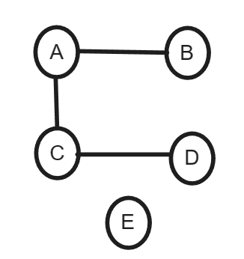
Implementation
We will store the sets in the form of tree.

Slide 20
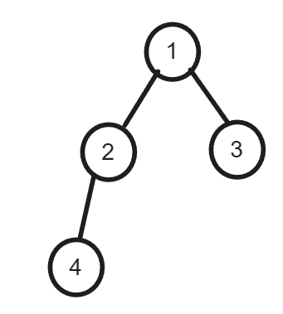
Implementation
We won’t use adjacency list / matrix.
We will use an array called parent array.
0 | 1 | 2 | 3 | 4
0 | 1 | 1 | 1 | 2

Slide 21
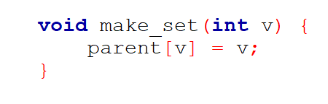
Implementation
Initialization
At first each element will belong to its own set and hence will be the parent of its own tree.

Slide 22
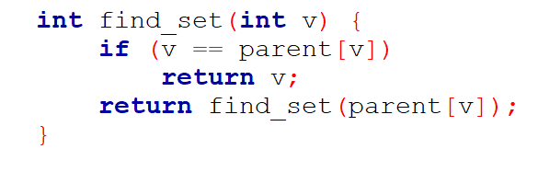
Implementation
find_set(v)
We will traverse the tree upward till we reach the root (parent[a] = a).

Slide 23
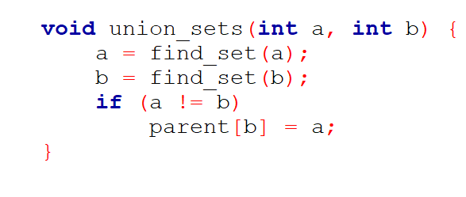
Implementation
union_sets(a,b):
Find the parent of each element.
If they are not same
Connect them.

Slide 24
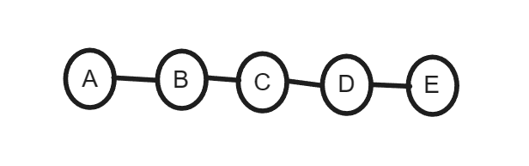
Problem in Implementation
It is easy to create example that constructs a long chain.
Make D and E friends.
Make C and D friends.
Make B and C frieinds.
Make A and B friends.

Slide 25
Path Compression Optimization
Optimizes the find_set(v) function.
Notice that when we call find_set(v) for some node
We find the representative of all the nodes in the path from root to v.
If we update the parent of all these nodes the paths becomes shorter.

Slide 26
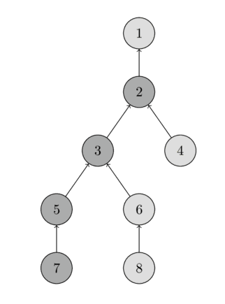
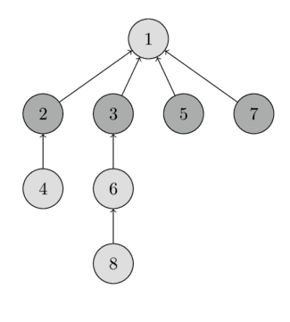
Path Compression Optimization
Call find_set(7)

Slide 27
Union by Size / Rank
Self Study

Slide 28
Complexity
Combine both optimizations – path compression with union by size/rank.
Final amortized complexity is O(α(n)).
α(n) is called inverse Ackermann function.
It grows very slowly and can be compared with O(1).

Slide 29
Important links
Amortized Complexity:
algorithm - What is Constant Amortized Time? - Stack Overflow
Ackermann Function:
Ackermann function - Wikipedia

